Slide 1





Department of Software Engineering Faculty of Science and Information Technology Daffodil International University
FakeSpy-A Machine Learning Based Framework To Detecting Fake News

Slide 2

Presented By Abu Bakkar Siddikk 171-35-1994 Sec: C Department of Software Engineer (SWE) Daffodil International University
Supervised By
Mr. Md. Shohel Arman
Lecturer (Senior Scale)
Faculty of Science and Information Technology
Department of Software Engineering
Daffodil International University

Slide 3
Abstract
Fake news is false or misleading information presented as news. It often has the aim of damaging the reputation of a person or entity, or making money through advertising revenue. It can mislead us towards wrong direction. Thus, Fake News Detection has attained massive deal of interest from researchers all over the world.
The proposed framework also will help to understand how much data is responsible for detecting fake news, trying to stage the linguistic differences between fake and true articles providing a visualization of the results using many visualization tools. Another major aim of this article presents a comprehensive performance evaluation of is to compare popular different machine learning classifiers like Support Vector Machine, Naïve Bayes Method, Decision Tree Classifier, Random Forest, Logistic Regression as well as to develop an ensemble method (Bagging & Boosting) like XGBClassifier, Bagging Classifier of different combinations of classification models to identify which gives best optimal results for all three data part of datasets. As a result, it has been found that with an appropriate set of features extracted from the texts and the headlines, where XGB classifier can effectively classify fake news with very high detection rate. This framework also provides a strong basement of intelligent anti-fake news detector

Slide 4
Background
For the purpose of fake news to resolve those problem researcher worked on different model. Author develop many model and approach to detect fake news as follow.
Develop a machine learning program to identify fake/unreliable news based on content acquired.
Author Finding and Improving accuracy of existing fake news detection using Deep Convolutional Neural Network.
Similar Machine Learning Algorithm, Author used to identified best Accuracy to detect fake news (Ensamble-Bagging and Boosting)
Researcher’s Used performance parameters, optimizer in Deep Neural Network to find the best model and it’s a way to detect fake news.
Appling K-fold Cross-Validation, N-gram and many Feature Selection techniqeue to improve the accuracy as well as perform as a best prediction.

Slide 5
Motivation
In this context the present article makes the following contributions:
Proposed a Framework based on machine-learning to detecting fake news.
Our goal is to develop a reliable framework that classifies a given news article as either fake or true.
Emerging research area in Natural Language Processing(NLP).
Will Evaluation environment, competitors, datasets, performance measures to find the best accuracy using ML models.

Slide 6
Problem Statement
The target of this study is to propose an optimized framework. Basically, the following problems are going too implemented in this study:-
To find out the best and efficient machine learning based framework to detect the fake news.
Find out the best machine learning algorithm to be used for detect fake news accurately.
To detect after analysis on dataset how much data are really responsible to detect the fake news properly.
Implemented the best novel feature extraction technique for better performance and which will be able to fit in model to detect the fake news more efficiently.

Slide 7
Research Question
Q1- How machine learning based framework is proven to be more efficient to predicting the fake news.
Q2- How dataset really responsible to detect the fake news more effectively after slicing the dataset.

Slide 8
Scope
To Detect or Identify the True/Fake news or Article among Fifty Thousand data to help avoid the rumor.
Investigate is a long process to identified which is true or false news but this system will help to identify fake news within a second.
Prediction based on “text or article” using machine Learning will help people, politicians and industrial level etc.
Providing the best machine learning based framework will help people to be aware from the rumor finding the best predictable result.
Applying the Ensemble classification achieved best accuracy which clearly said this work will provide trust information which is mostly will be help for the politicians or other

Slide 9
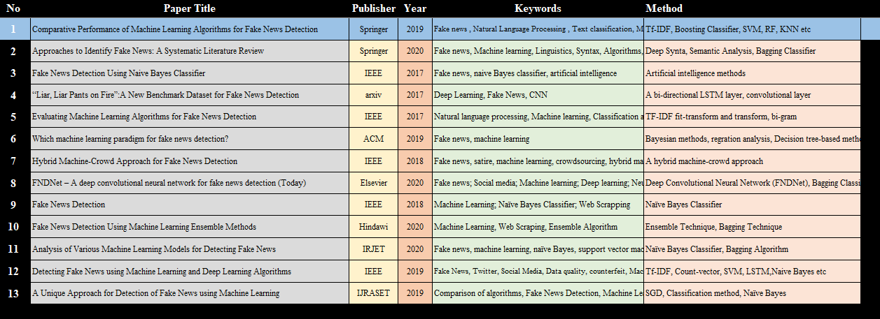
Literature Review
Notes:
After consulting a variety of sources, you will need to narrow your topic. For example, the topic of internet safety is huge, but you could narrow that topic to include internet safety in regards to social media apps that teenagers are using heavily. A topic like that is more specific and will be relevant to your peers. Some questions to think about to help you narrow your topic:
What topics of the research interest me the most?
What topics of the research will interest my audience the most?
What topics will the audience find more engaging? Shocking? Inspiring?

Slide 10
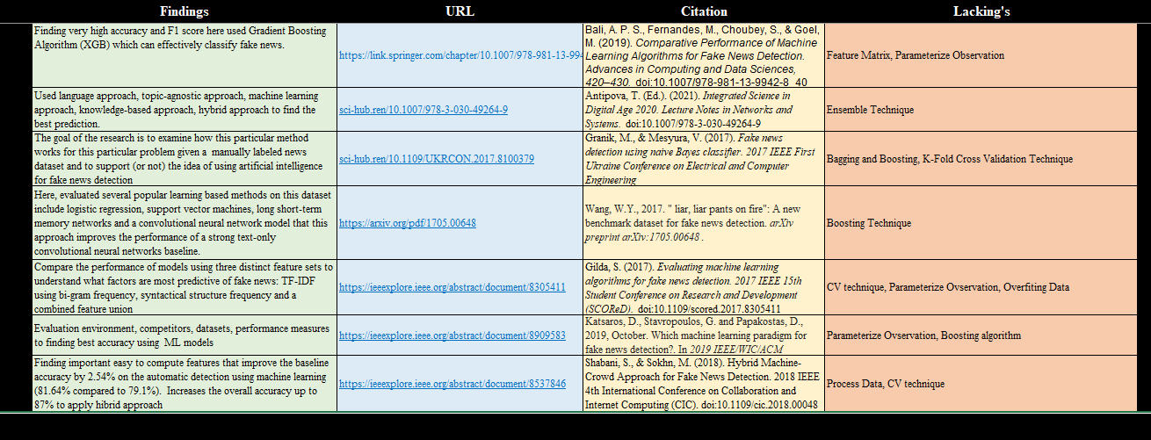
Literature Review

Slide 11
Dataset Collection
This Thesis based on Classification problem with the Discrete dataset and it’s Qualitative Research.
Most of the part of fake and true dataset are collected from kaggle repository. Some of true data are collected from many reliable data source website like- BBC, CCN, The New York Time etc. Total 44909 (https://doi.org/10.6084/m9.figshare.13325198.v1) data present this document where true news 21417 and fake news 23471 presented in this collection.
No. of feature | 5 Feature
True News | 21417
Fake News | 23471
Total Document | 44909
Notes:
When conducting research, it is easy to go to one source: Wikipedia. However, you need to include a variety of sources in your research. Consider the following sources:
Who can I interview to get more information on the topic?
Is the topic current and will it be relevant to my audience?
What articles, blogs, and magazines may have something related to my topic?
Is there a YouTube video on the topic? If so, what is it about?
What images can I find related to the topic?

Slide 12
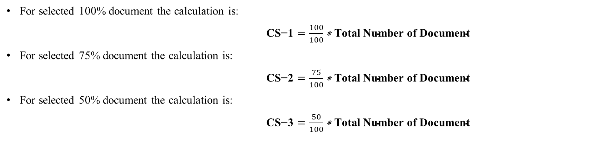
Dataset Divided
For selected 100% document the calculation is:
$\text{CS}\text{−}\text{1}=\frac{100}{100}\text{∗} \text{Total} \text{Number} \text{of} \text{Document}$
For selected 75% document the calculation is:
$\text{CS}\text{−}\text{2}=\frac{75}{100}\text{∗} \text{Total} \text{Number} \text{of} \text{Document}$
For selected 50% document the calculation is:
$\text{CS}\text{−}\text{3}=\frac{50}{100}\text{∗} \text{Total} \text{Number} \text{of} \text{Document}$

Slide 13
Data Preprocessing
Convert all document into lowercases
Remove the unwanted features which are not related to our model
Remove stop word, punctuation character to find out the actual machine able word
To Reducing duplicated document, for less overfitting models that reason shuffling the data randomly.
Splitting the dataset into a group.

Slide 14
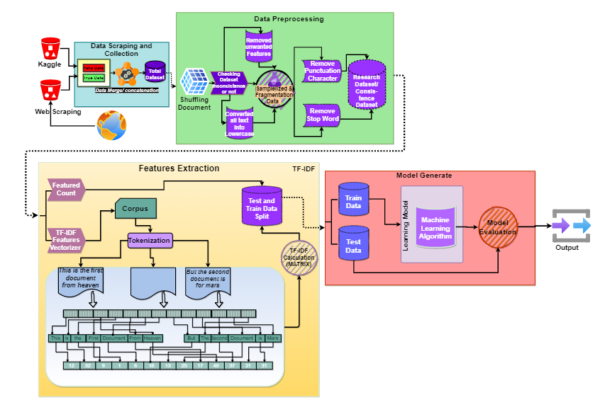
Slide 3
Methodology

Slide 15
Model Used
Support Vector Machine
Decision Tree
K-Nearest Neighbors
Logistic Regression
Random Forest
Passive Aggressive Classifier
Multinomial Naïve Bayes
XGB Classifier

Slide 16
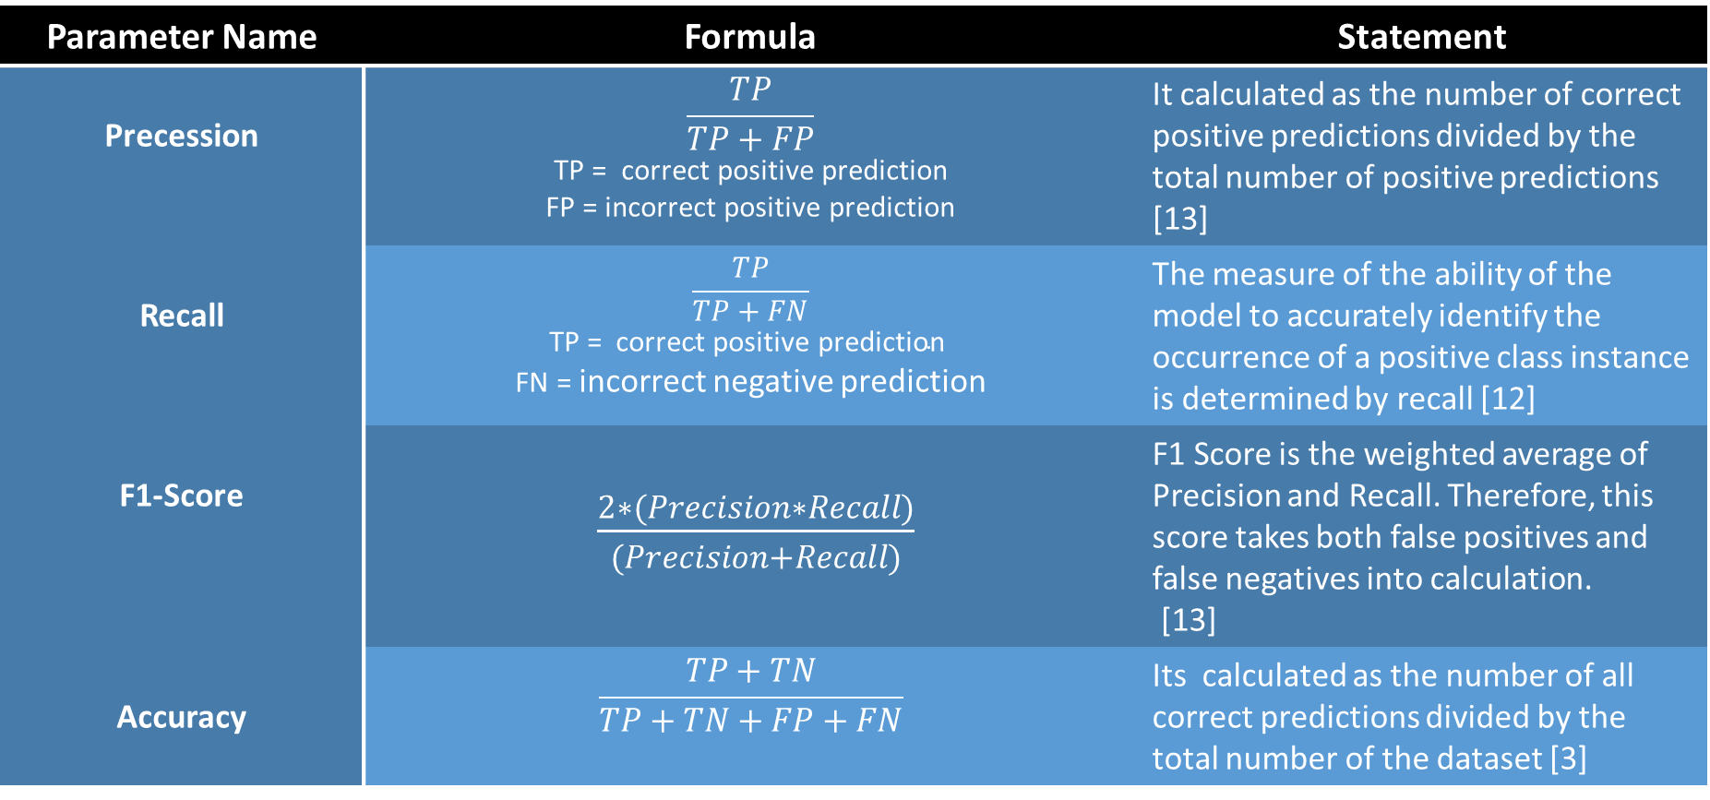
Evaluation Parameters
Parameter Name | Formula | Statement
Precession | $$\frac{TP}{TP+FP}$$ TP = correct positive prediction FP = incorrect positive prediction | It calculated as the number of correct positive predictions divided by the total number of positive predictions [13]
Recall | $$\text{TP}\text{ = }\text{correct} \text{positive} \text{prediction} \frac{TP}{TP+FN}$$ FN = incorrect negative prediction | The measure of the ability of the model to accurately identify the occurrence of a positive class instance is determined by recall [12]
F1-Score | $\frac{2∗(Precision∗Recall)}{(Precision+Recall)}$ | F1 Score is the weighted average of Precision and Recall. Therefore, this score takes both false positives and false negatives into calculation. [13]
Accuracy | $$\frac{TP+TN}{TP+TN+FP+FN}$$ | Its calculated as the number of all correct predictions divided by the total number of the dataset [3]

Slide 17
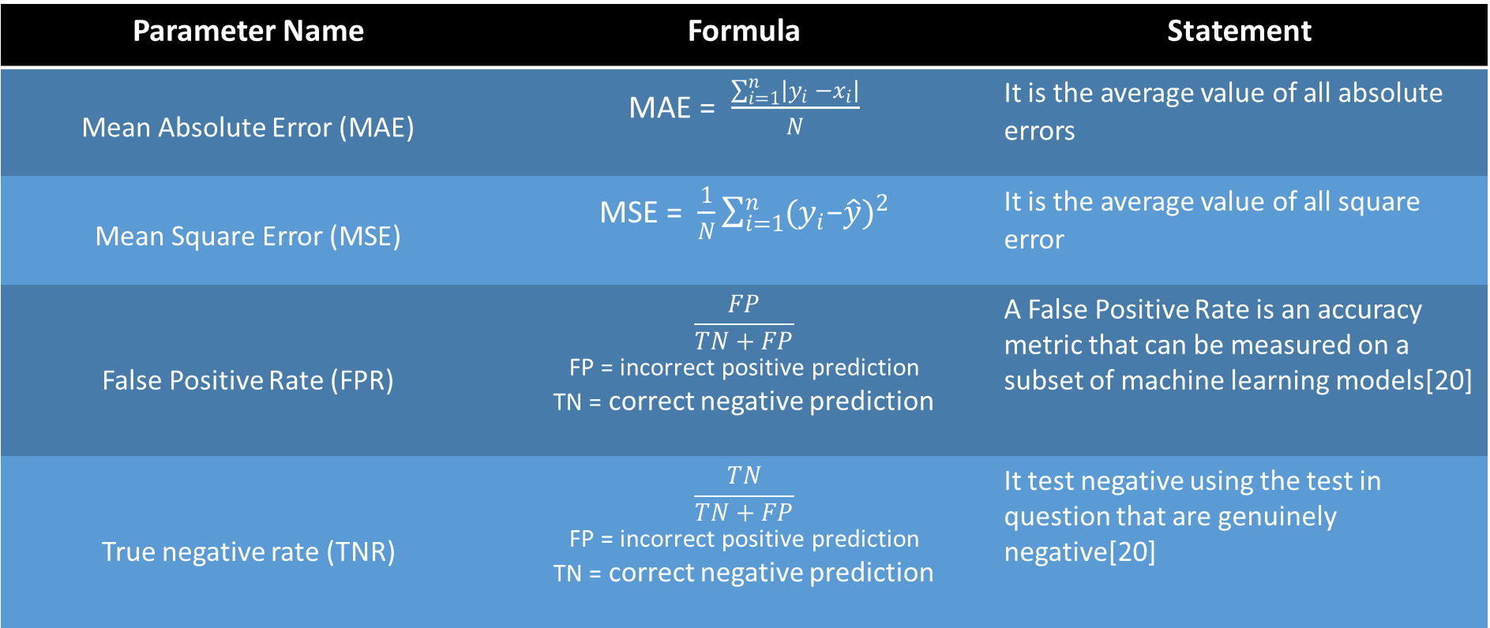
Evaluation Parameters
Parameter Name | Formula | Statement
Mean Absolute Error (MAE) | MAE = $\frac{\sum_{i=1}^{n}{\left|y_{i} −x_{i}\right|}}{N}$ | It is the average value of all absolute errors
Mean Square Error (MSE) | MSE = $\frac{1}{N}\sum_{i=1}^{n}{{(y_{i}\text{−}\hat{y})}^{2}}$ | It is the average value of all square error
False Positive Rate (FPR) | $$\frac{FP}{TN+FP}$$ FP = incorrect positive prediction TN = correct negative prediction | A False Positive Rate is an accuracy metric that can be measured on a subset of machine learning models[20]
True negative rate (TNR) | $$\frac{TN}{TN+FP}$$ FP = incorrect positive prediction TN = correct negative prediction | It test negative using the test in question that are genuinely negative[20]

Slide 18
Confusion Matrix
Name | Statement
True Positive (TP) | The number of true positive examples is the number of news articles, correctly classified as fake
False Positive (FP) | The number of false positive examples is the number of news articles incorrectly classified as fake
False Negative (FN) | The number of false negative examples is the number of news articles incorrectly classified as true
True Negative (TN) | The number of true negative examples is the number of news articles, correctly classified as true
 | Predicted Positive | Predicted Negative
Actual Positive Actual Negative | True Positive(TP) | False Negative(FN)
 | False Positive(FP) | True Negative(TN)

Slide 19
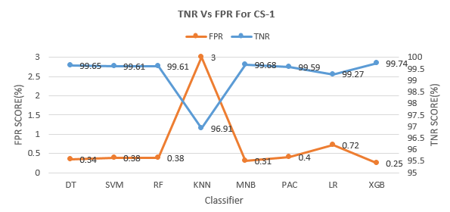
Confusion Matrix
Confusion Matrix For the Case Study-01

Slide 20
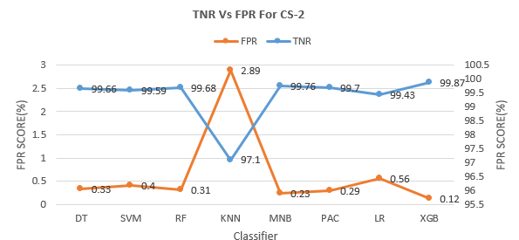
Confusion Matrix
Confusion Matrix For the Case Study-02

Slide 21
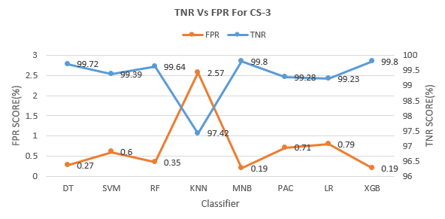
Confusion Matrix
Confusion Matrix For the Case Study-03

Slide 22
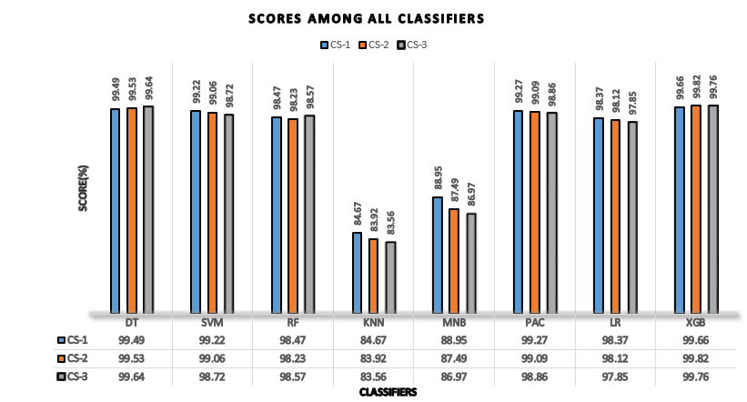
Different Machine Learning Performance Results
The classification models which are taking for the investigation in this manuscript given highest performance for XGB models and given less performance for KNN models for the given three part of dataset.
But the important point is that the DT classification have been increased when this propose document gradually decrease. On the other hand SVM, KNN, MNB, PAC and LR classifier has been decrease when this proposed document gradually decrease.
Figure -: Different Machine Learning Accuracy Results

Slide 23
Precision, Recall and F1-Score for Machine Learning algorithm
Table -: Precision, Recall and F1-Score for Machine Learning algorithm
Using formula from classification matrix have found highest precision, F1-score and recall for the Decision Tree classification model of CS-1. For CS-2 have been found highest precision, recall and f1-score only for XGB classifier. For CS-3 given same result 99.98 as a highest result for the precision, recall and f1-score

Slide 24
Accuracy of Word Embedding Model (TF-IDF)
Table -: Accuracy of Word Embedding Model (TF-IDF) for Machine Learning algorithm
Using the word embedding model TF-IDF in this experiment have achieved 99.66, 99.82 and 99.76 highest accuracy using three amount of dataset. for XGB classifier among all classification model. Apart from lowest accuracy have found for KNN models.

Slide 25
Comparison-based Classification result
Table -: Comparison-based Classification result using Kaggle Fake News Dataset
As illustrate table shows different author and their proposed model which have performed based on their model. Following is the conﬁguration of the computing environment for carrying out the experiment.
The proposed Framework shows comparatively best results and effectively (training accuracy, testing accuracy also light-weight model for training). This Framework play a significant role in the fake news detection.
Using proposed Framework we were achieved an accuracy of 99.66%. This framework achieved better result with the real-world text based fake news dataset as compared to existing works. From the above table clearly said that our proposed framework strongly encourage all researchers that is most significant framework to detect fake news.

Slide 26
Conclusion and Future Scope
In recapitulate, the implementation of eight machine learning algorithms in accordance with TF-IDF has been performed to establish a matured process of detecting the fake news. It’s been examined that for checking the confirmation of information separated from the dataset which offers general responses for data amassing and interpretive show towards counterfeit fake news recognition. It’s also been found that KNN has given the less performance measure where boosting classifier has given the highest performance to detect the fake news. Additionally, ensemble techniques will be the best fit to solve the complex issues which have fall impact for all over the world for the purpose of identifying fake news. This work explained with extensive comprehensive that with a hot and various set of features extracted from the heading and the text, speciﬁcally the XGB classiﬁer can efﬁciently detect fake news with 99.66% accuracy and 98.55% f1-score for the CS-1, 99.82% accuracy and 99.75% f1-score for the CS-2 and 99.76% accuracy and 99.76% f1-score for the CS-3. For the less data it can be recommended to use decision tree classifier to detect fake news. A number of features and using different two-word or three-word embedding models for the purpose to comprising other model in addition deep learning and their model optimizers as well as other linguistic features along with the other feature extraction technique has not explored in this paper, could be added to other feature extraction technique and deep learning model with the optimizers and two or more feature in future for the shake of better performance.

Slide 27
Conclusion and Future Scope
A number of features and using different two or three word embedding model for the purpose to comprising other model in addition deep learning and their model optimizers as well as other linguistic features and other feature extraction technique not explored in this paper, could be added to other feature extraction technique and deep learning model with their optimizer and two or more feature in future for the shake of better accuracies and performance

Slide 28

Notes:
You can use this slide as your opening or closing slide. Should you choose to use it as a closing, make sure you review the main points of your presentation. One creative way to do that is by adding animations to the various graphics on a slide. This slide has 4 different graphics, and, when you view the slideshow, you will see that you can click to reveal the next graphic. Similarly, as you review the main topics in your presentation, you may want each point to show up when you are addressing that topic.
Add animation to images and graphics:
Select your image or graphic.
Click on the Animations tab.
Choose from the options. The animation for this slide is “Split”. The drop-down menu in the Animation section gives even more animations you can use.
If you have multiple graphics or images, you will see a number appear next to it that notes the order of the animations.
Note: You will want to choose the animations carefully. You do not want to make your audience dizzy from your presentation.

